Slide 1
Reducing Age Bias in Machine Learning: An Algorithmic Approach
Adriana Solange Garcia de Alford,
Steven Hayden, and Nicole Wittlin
Amy Atwood, adviser

Slide 2
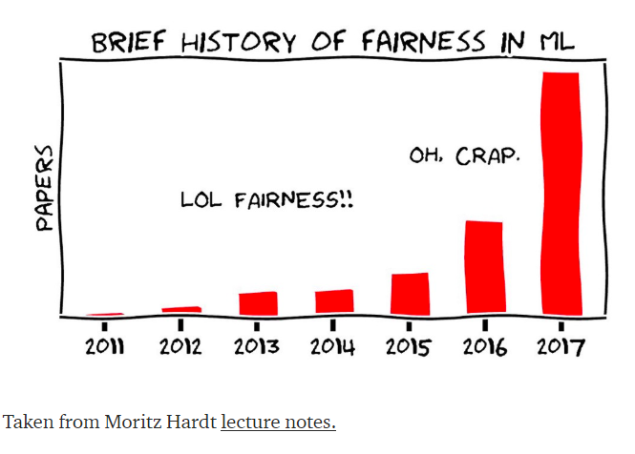
Bias in Machine Learning
Is it BIASED because it is UNFAIR?
Is it UNFAIR because it is BIASED?

Slide 3
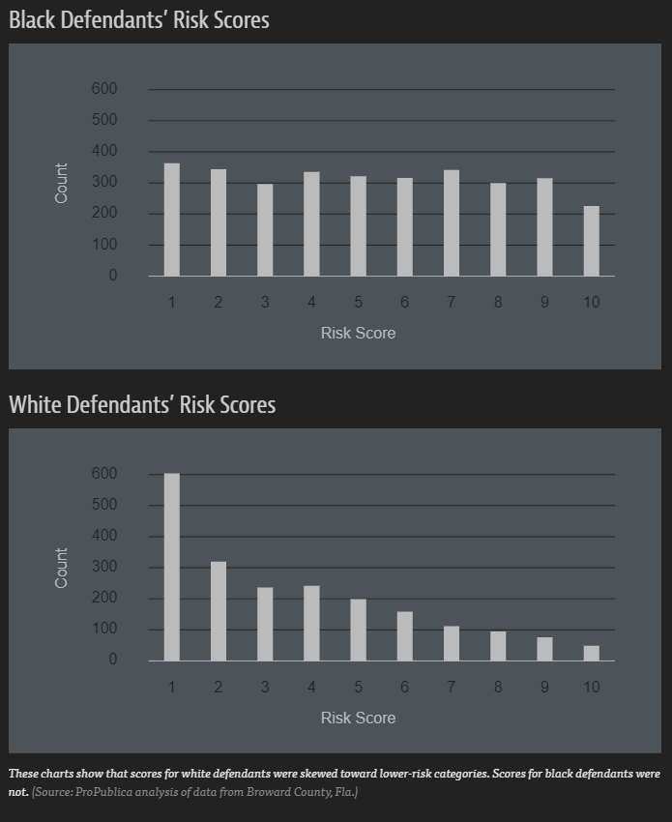

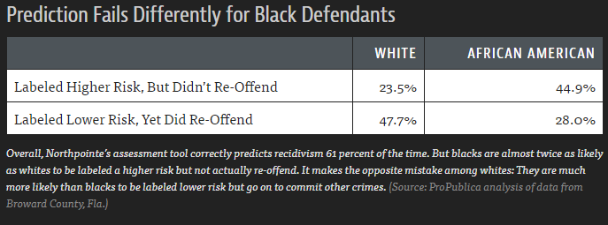
Bias in Machine Learning
COMPAS
Male : Doctor | Female : Nurse
Man : Computer Programmer | Woman : Homemaker

Slide 4
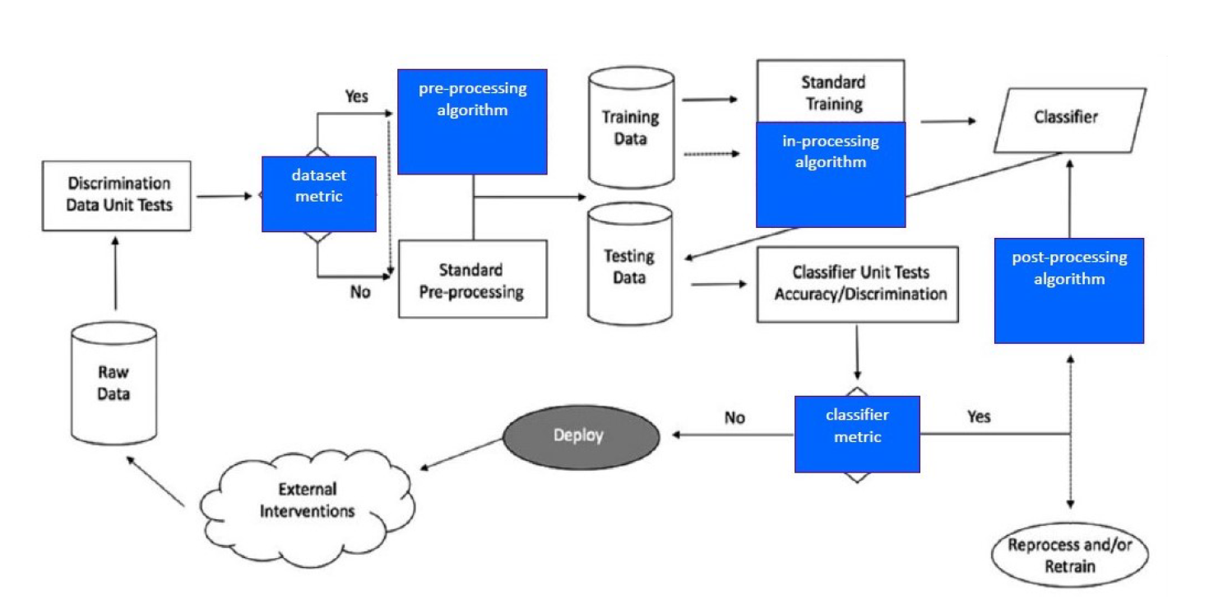
Bias in Machine Learning
PROCESS
DATA
PEOPLE

Slide 5
Bias in Machine Learning
Pre-Processing
In-Processing
Post-Processing
Intervention Points

Slide 6
Bias in Machine Learning
Pre-Processing
In-Processing
Post-Processing
Classification
Regression
Adversarial Debiasing
Prejudice Remover

Slide 7
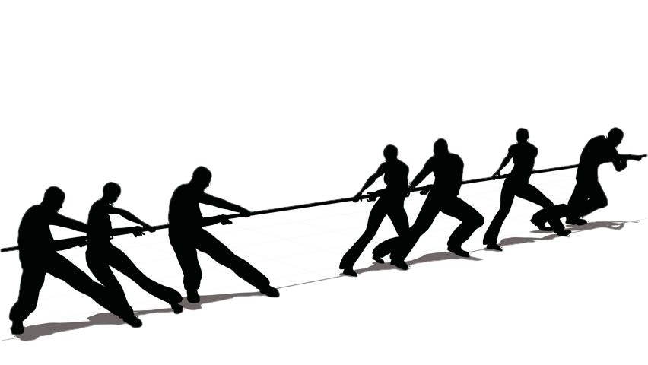
GAN Overview
Two competing modes
https://ya-webdesign.com/imgdownload.html

Slide 8
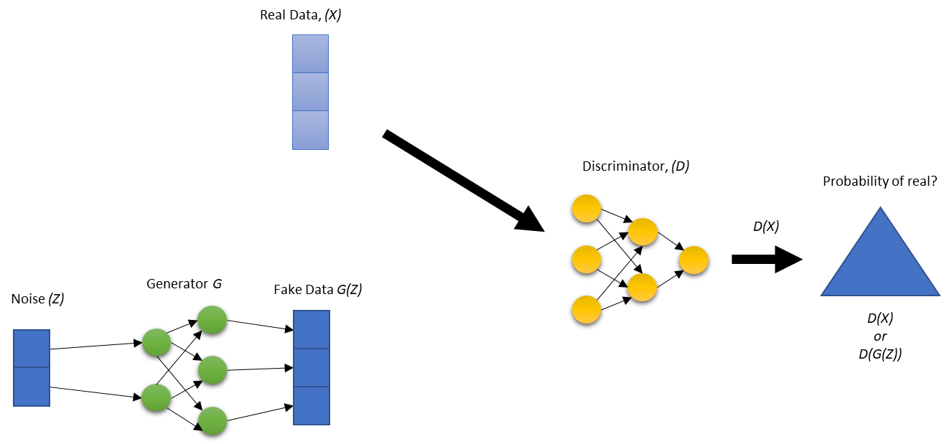
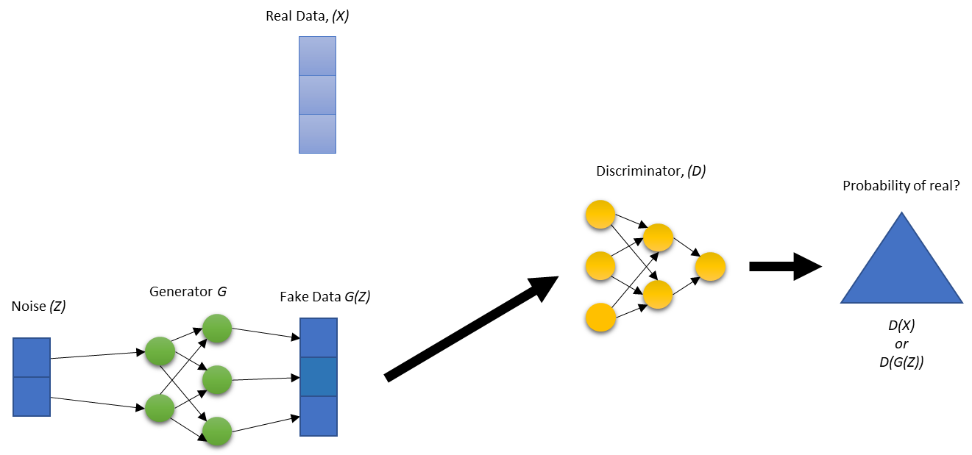
GAN Overview
https://ya-webdesign.com/imgdownload.html
Notes:
We got our inspiration from the GANS Framework
You have two algorithms competing against each other trying to minimize some loss function
In the first image you have real data passed to the discriminator (agl1) to predict if it is real or not.
In the second you have the generator taking noise and transforming it in its network to try and trick the discriminator.
Depending on what network was wrong, that is the one that will be updated.

Slide 9
Inspiration Work
Overview of Zhang work
Adversarial model to remove bias in the prediction model
Probability distribution from prediction model to predict protected attribute
Binary protected class

Slide 10
Experiment
Understand Employee Attrition
Protected attributes
Dropping protected attributes

Slide 11
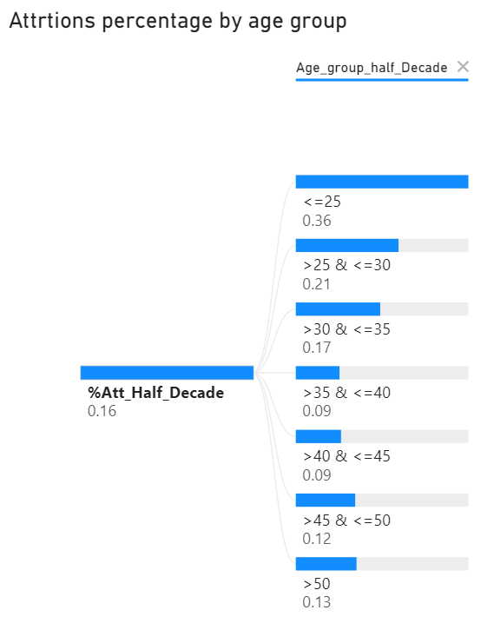
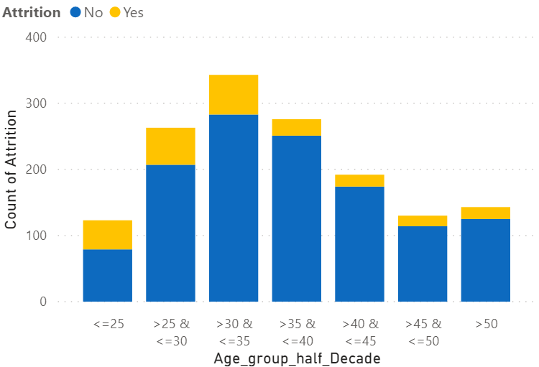
Experiment
Understand Employee Attrition
Notes:
We used the synthetic IBM Attrition data for our experiment.
As you can see the data is unbalanced with yellow = they left.
The younger Age groups have a greater percentage of attrition.

Slide 12
Experiment
Overview Experiment
Age(Z) is protected
Age(Z) Correlated with explanatory (X) of predictor model
Goals
Demographic Parity
Both protected and unprotected classes receive a positive outcome at equal rates.
Notes:
Age is a protected attribute and we do not want age to influence the outcome.
Most the time the protected attributes are just dropped, but other variables could be used as a substitute or is correlated with the protected attribute.
For example, years worked at the company
Our goal is to achieve or get closer to Demographic Parity by distributing accuracy across the age groups.

Slide 13
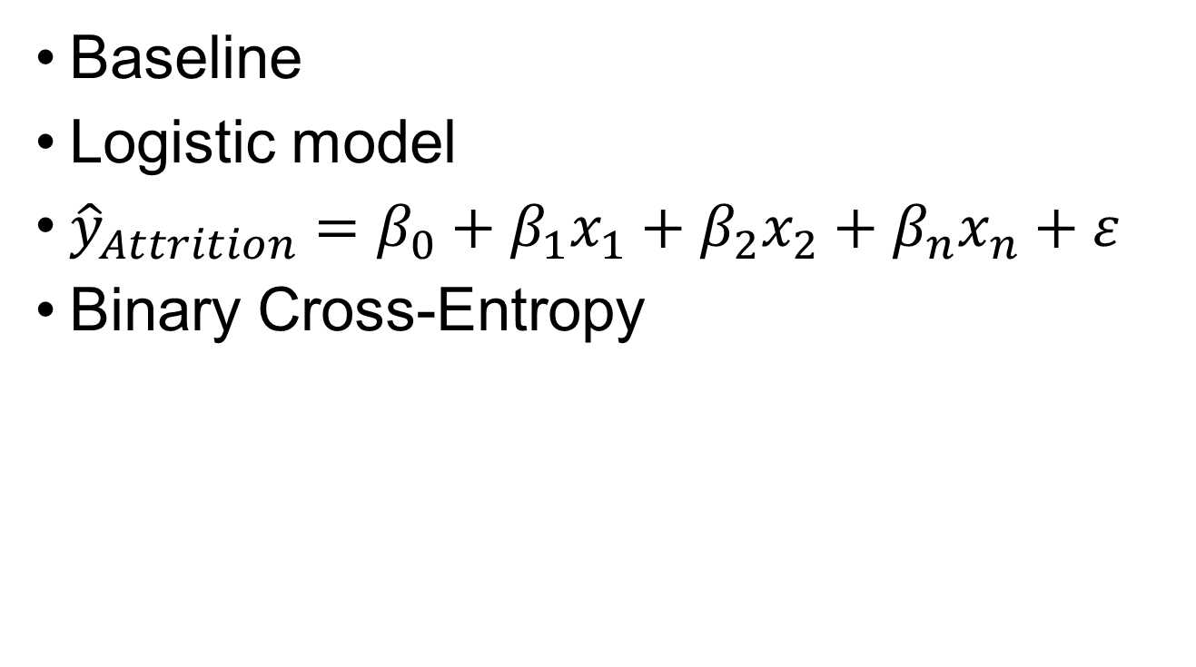
Experiment
Baseline
Logistic model
${\hat{y}}_{Attrition}=β_{0}+{β_{1}x}_{1}+{β_{2}x}_{2}+{β_{n}x}_{n}+ε$
Binary Cross-Entropy

Slide 14
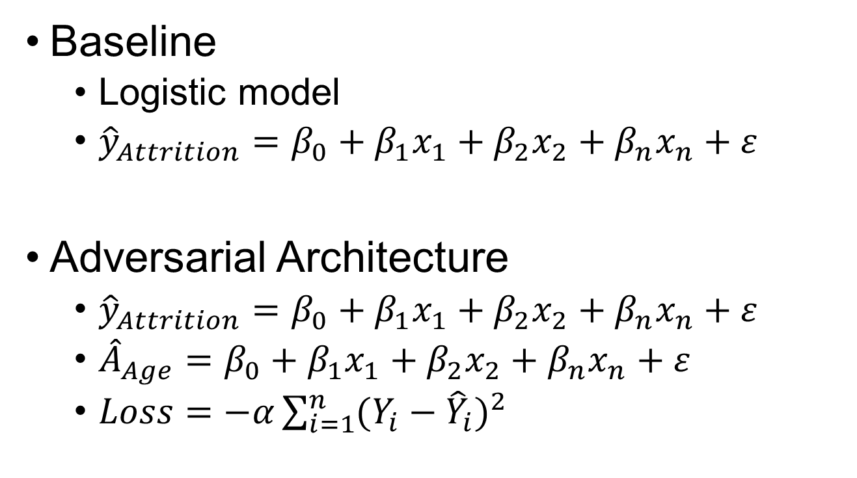
Experiment
Baseline
Logistic model
${\hat{y}}_{Attrition}=β_{0}+{β_{1}x}_{1}+{β_{2}x}_{2}+{β_{n}x}_{n}+ε$
Adversarial Architecture
${\hat{y}}_{Attrition}=β_{0}+{β_{1}x}_{1}+{β_{2}x}_{2}+{β_{n}x}_{n}+ε$
${\hat{A}}_{Age}=β_{0}+{β_{1}x}_{1}+{β_{2}x}_{2}+{β_{n}x}_{n}+ε$
$Loss=−α\sum_{i=1}^{n}{{(Y_{i}−{\hat{Y}}_{i})}^{2}}$
Notes:
We start with a baseline to see how close we are to demographic parity.
We created a simple neural net in the fashion of a logistic regression model. The idea is not to build the most accurate model but show that an adversarial can remove bias.
The adversarial framework adds in our adversarial model that tries to predict age (our protected variable).
The adversarial and the prediction models are wrapped together with a modified MSE that has a tunable parameter to dampen the gradients.
The loss is maximized because we want the model to be bad at predicting age.
The prediction algorithm is the same as in our baseline except the weights are modified from the MSE loss function as well as its original loss function .

Slide 15
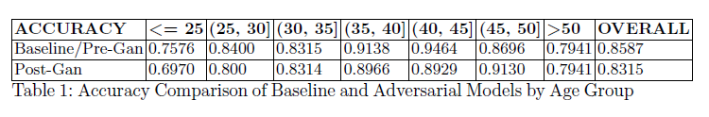
Experiment - Results (accuracy)
Results from the GAN model were compared to the baseline model
Accuracy in both models was expected to be similar
Groups less than 35 and our older population over 50, resulted in a lower accuracy on Attrition
Attributed this to the fact that the data set had a larger population in the middle age groups.

Slide 16
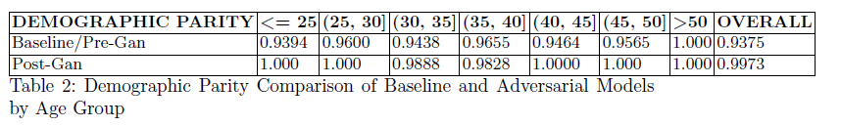
Experiment - Results (Demographic Parity)
No protected or unprotected groups
Compared fairness across age groups
Demographic parity is achieved when
Each group has equal likelihood to be assigned a positive outcome
If the proportion of positive predictions in the subgroups are closed to each other

Slide 17
Experiment - Results (Group Alignment)
We would like to have seen a more balanced distribution across age groups in the data
No significant pre-processing on the data (perhaps as a future exercise)

Slide 18
Experiment Results - Accuracy
Accuracy from the GAN model was compared to the baseline model
Accuracy in both models was expected to be similar
Groups less than 35 and our older population over 50, resulted in a lower accuracy on Attrition
Attributed this to the fact that the data set had a larger population in the middle age groups
Yet accuracy from GAN model, as expected, was lower

Slide 19
Experiment Results - Demographic Parity
Fairness
Fairness was compared across age groups in 5-year increments
No protected or unprotected groups
Demographic parity is achieved when
Each group has equal likelihood to be assigned a positive outcome
If the proportion of positive predictions in the subgroups are closed to each other

Slide 20
Conclusions
We would like to have seen a more balanced distribution across age groups in the data
No significant pre-processing on the data perhaps as a future exercise
Based on the comparative analysis between the baseline model and the GAN model, we think we achieved demographic parity
Most of the adversarial debiasing work we found was focused on protected groups such as race, sex and gender bias, but focus of our work was Age, and how can age bias be prevented in deep learning models

Slide 21
Conclusions
Another aspect of the code could be to refine it to create an “early stop” in the models when the adversary has sufficiently removed bias and correlation is no longer detected in the adversarial model for Z(X), Age of our input vector.
Ultimately, the opportunity to mitigate bias in continuous variables using adversarial network architecture shows promise yet we cannot become complacent and confident that systems are unbiased and fair.
A great number of tool kits, packages, process interventions, new techniques, or improved data collection currently exist, but we cannot and must not replace the sensitivity to foresee decisions’ consequence, inquisitiveness, skepticism, mortal imagination, and compassion that humans bring to bear to on machine learning

